Slide 1



Slide 2

…on my quest for local builds
https://github.com/IEvangelist/DocFX.Repository.Sweeper
directly inspired by the “CleanRepo” tool from Genevieve Warren - @gewarren

Slide 3
What is DocFx?
converts
markdown
into
<html/>

Slide 4
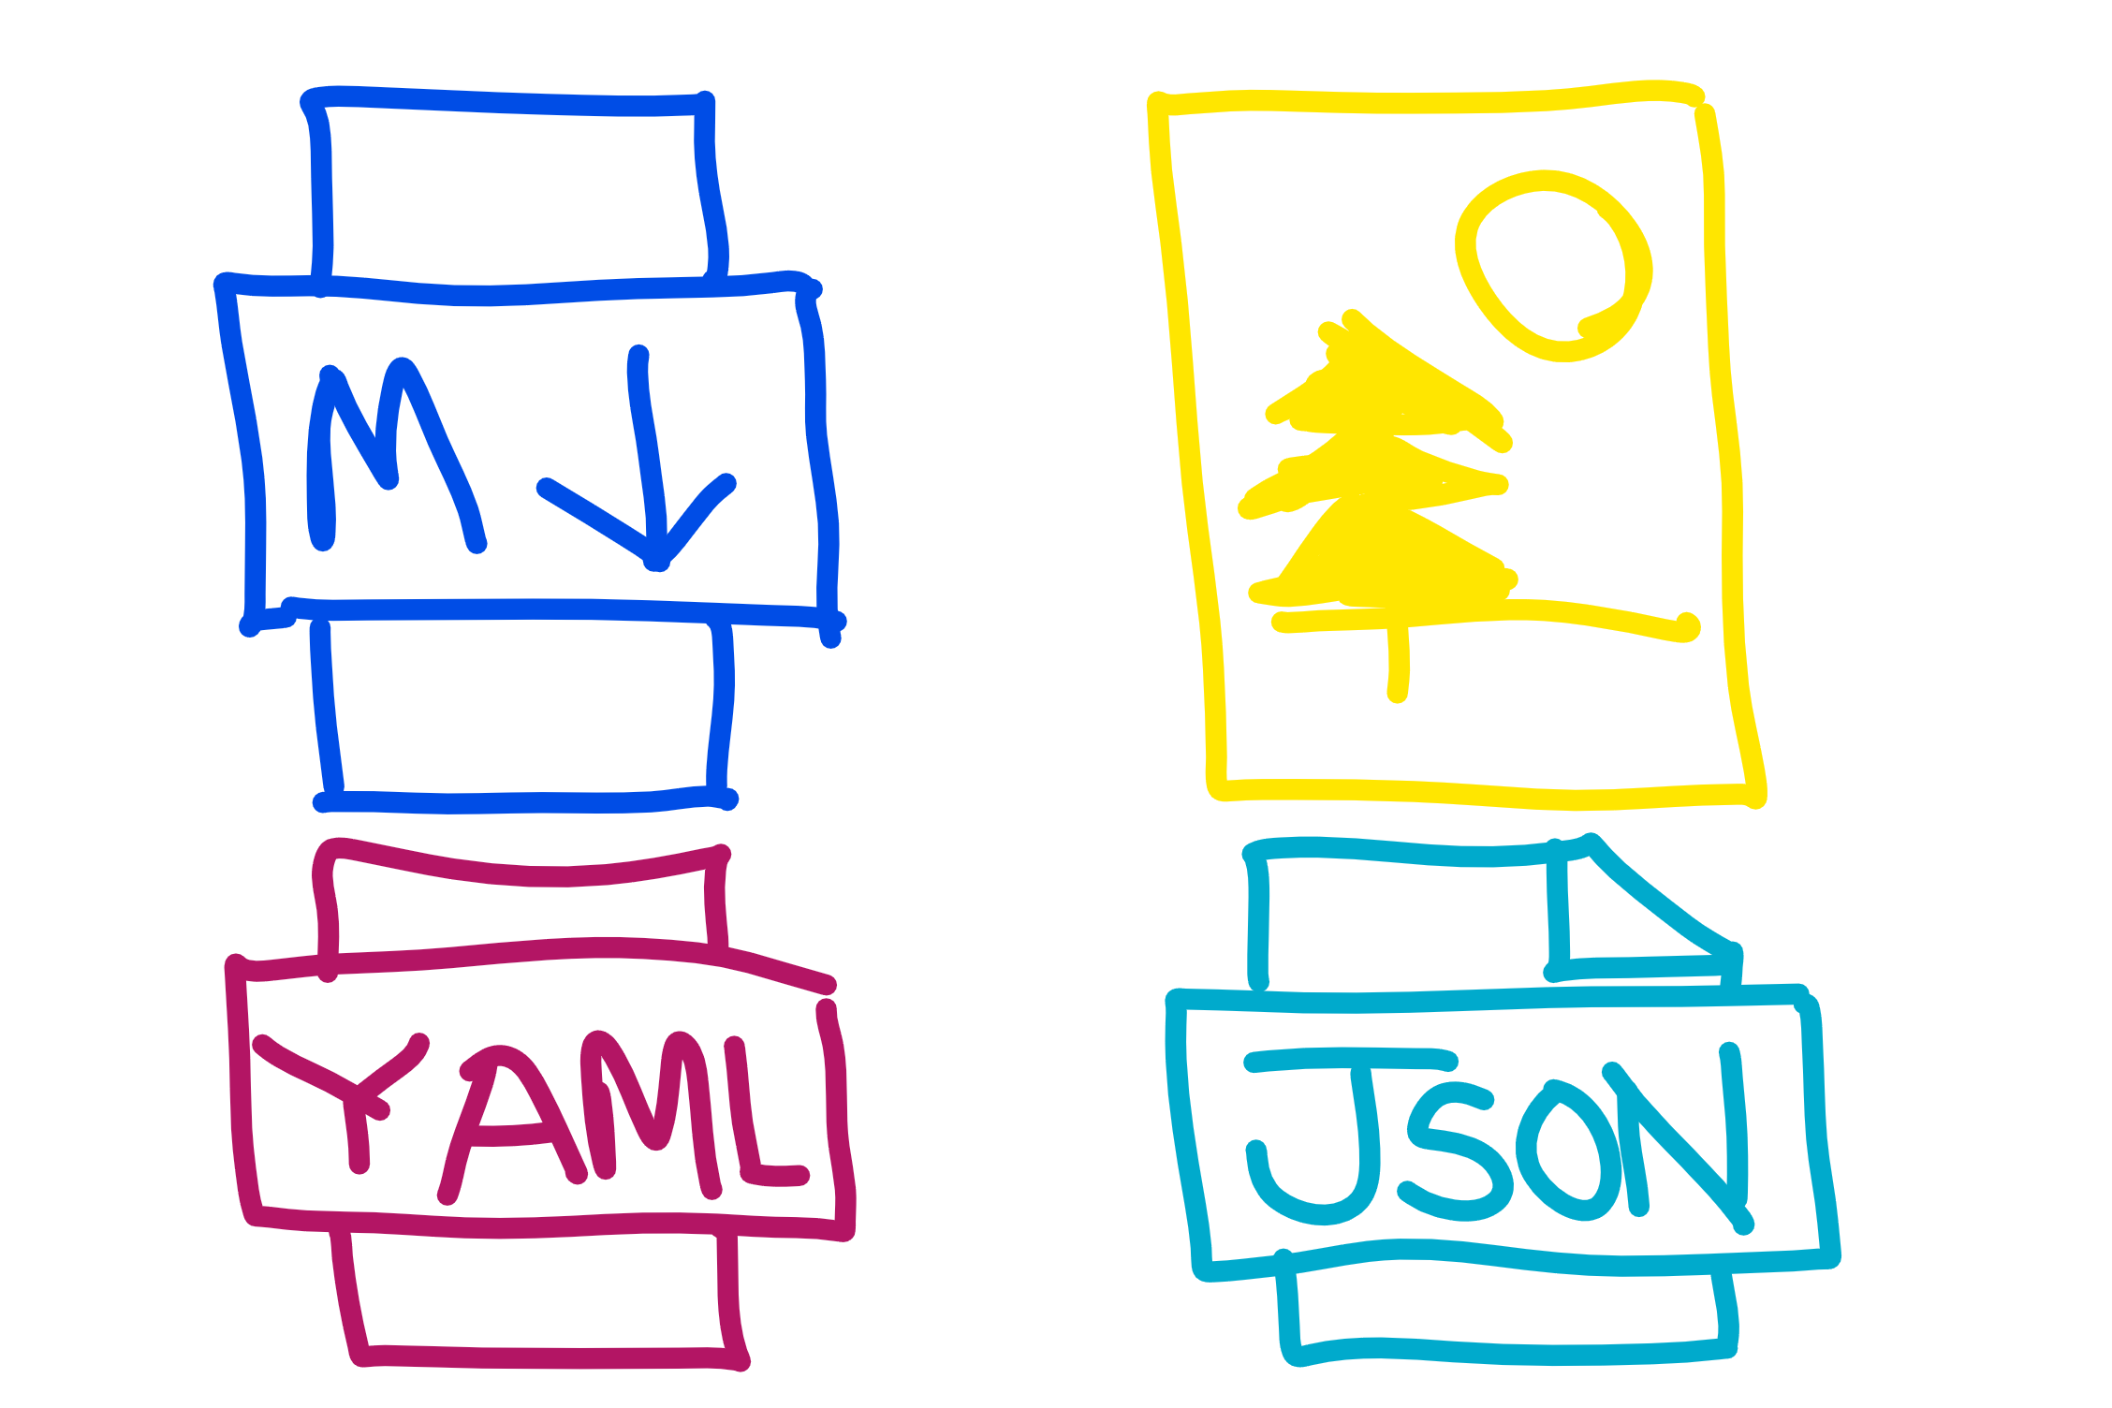

Slide 5
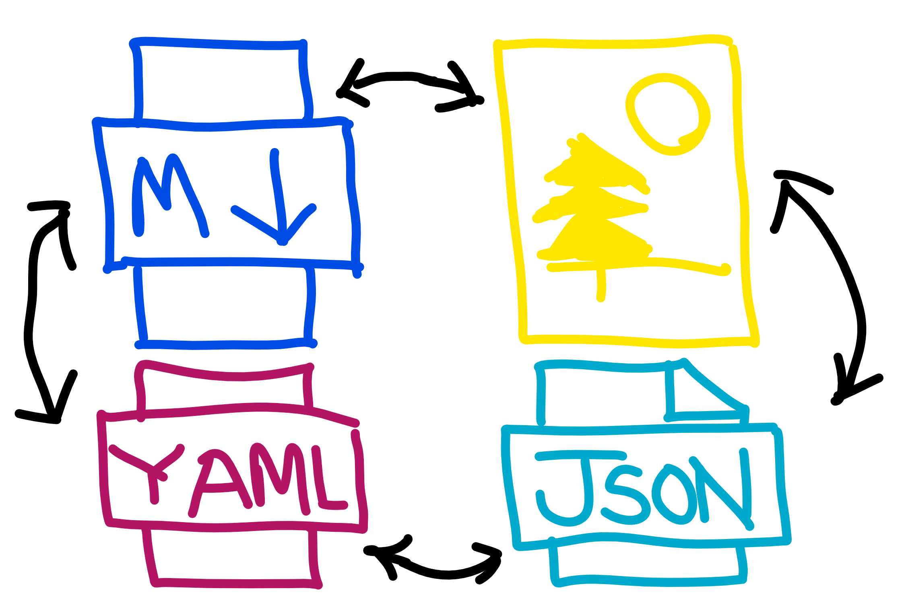

Slide 6
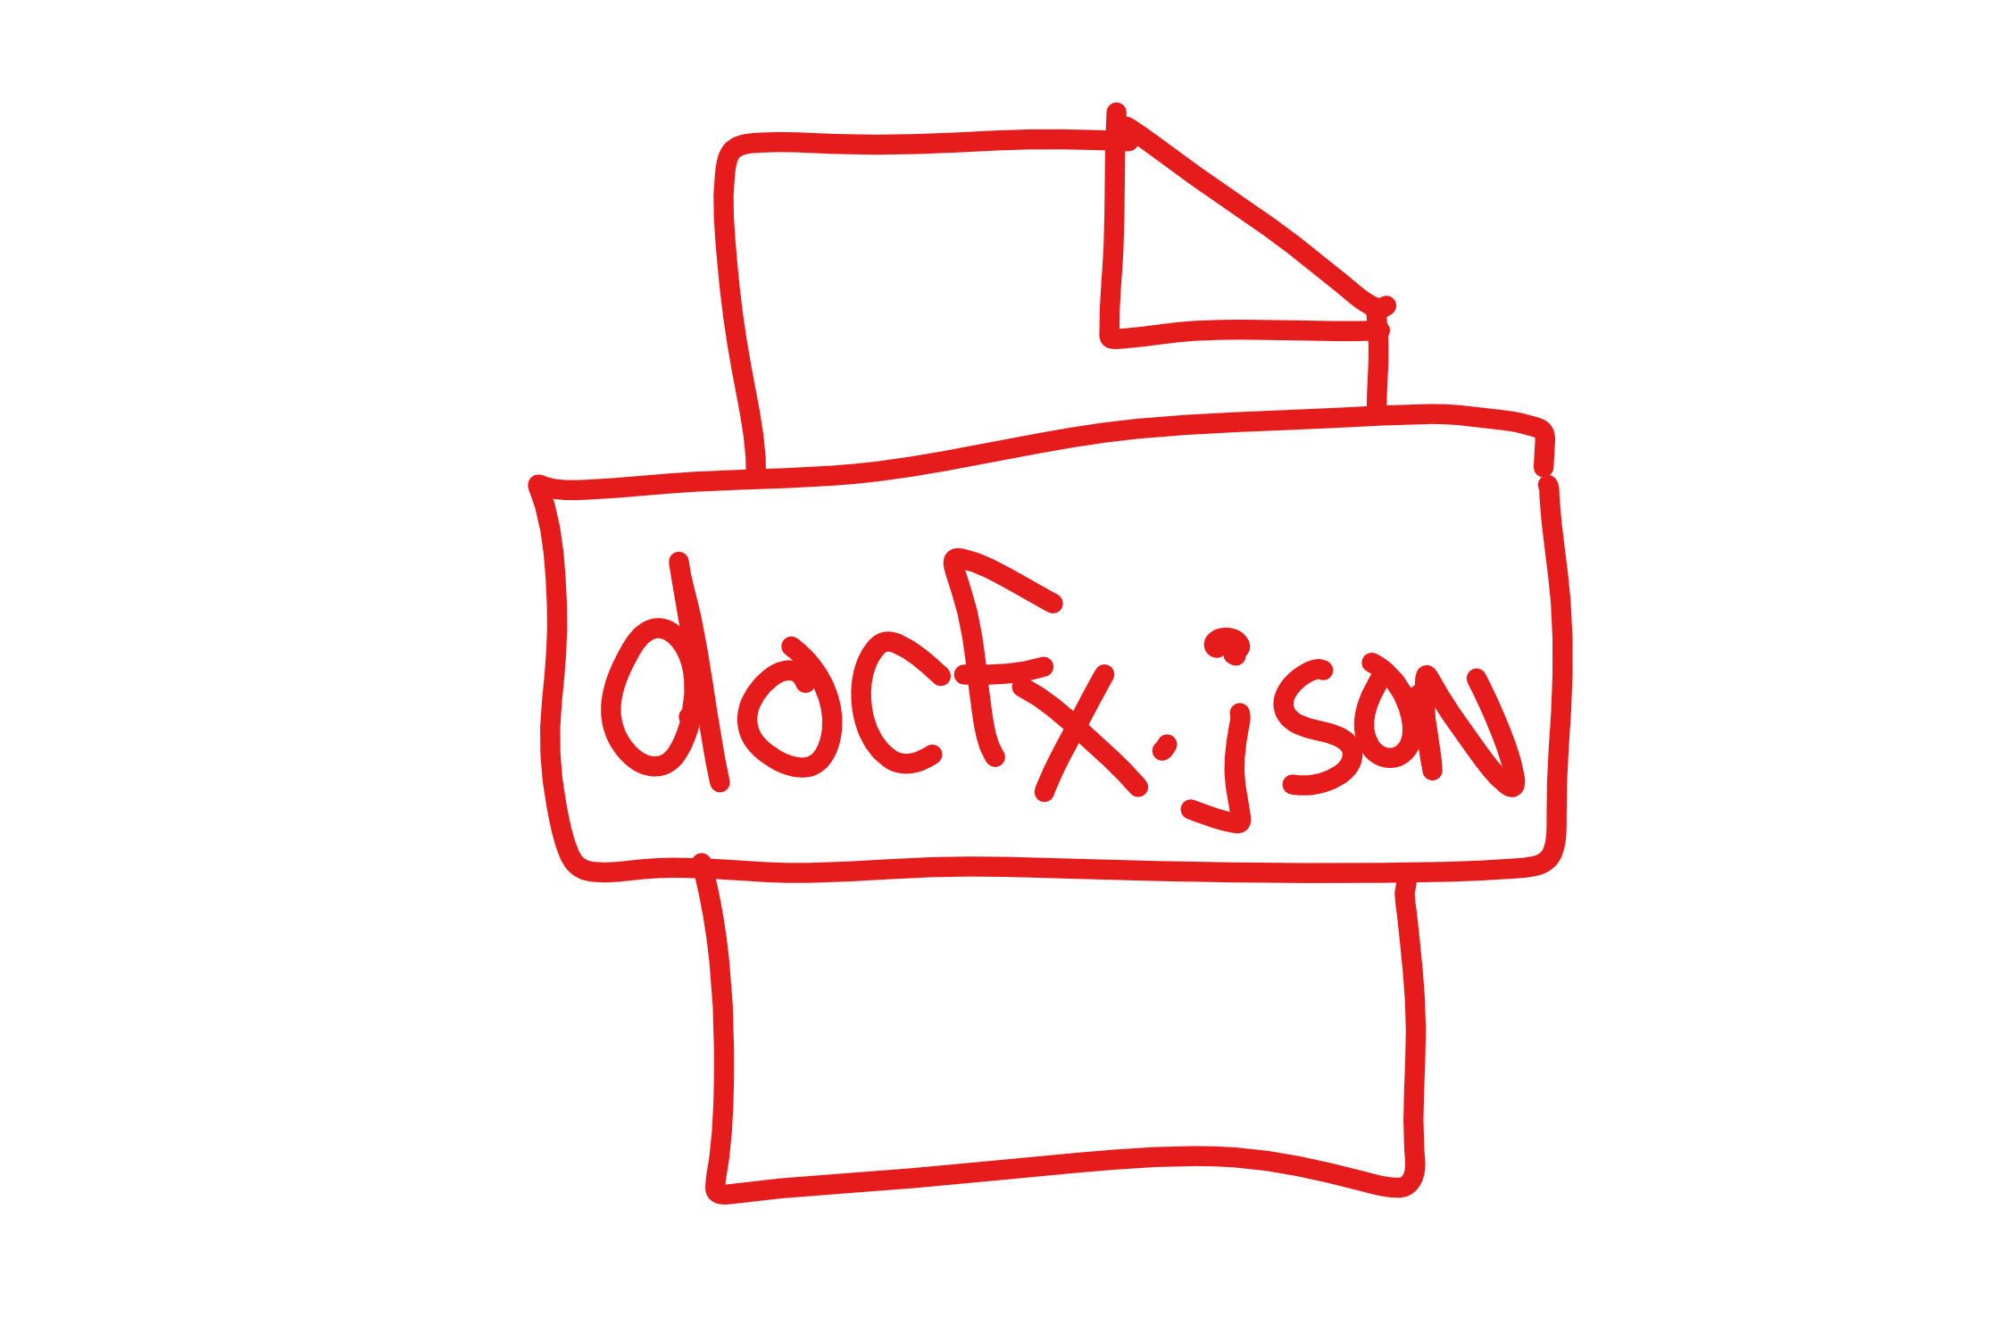

Slide 7
Great, now what?

Slide 8
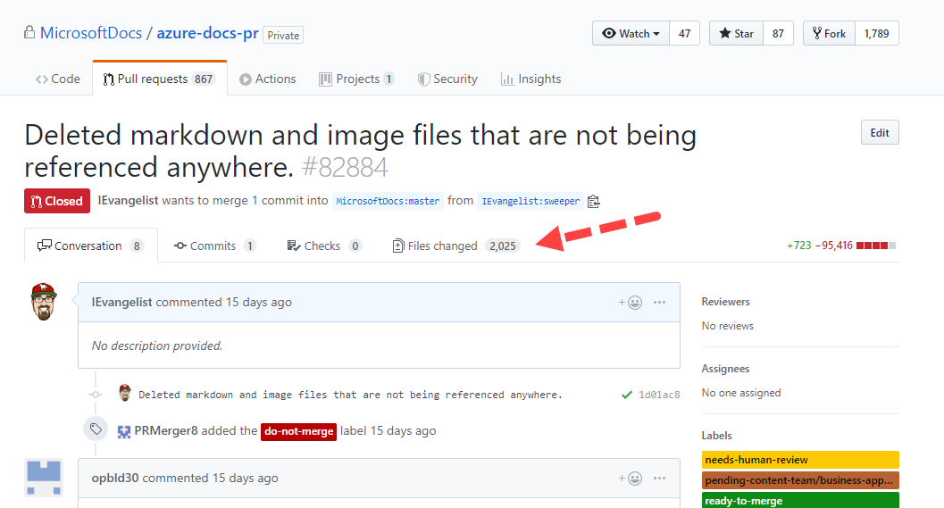
get their attention

Slide 9
Tokenize Cross References
Determine
Orphaned
Files

Slide 10
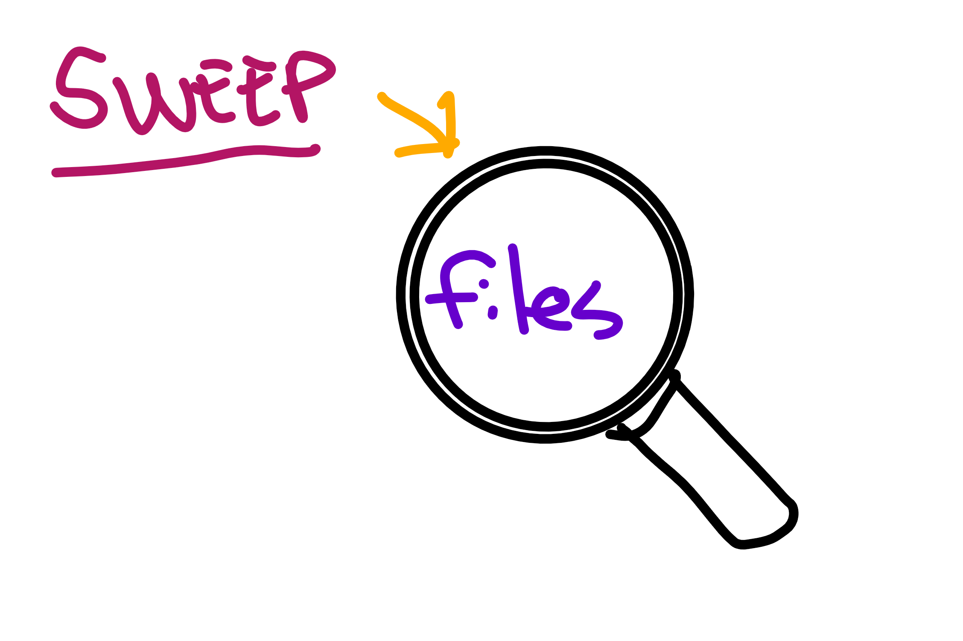

Slide 11
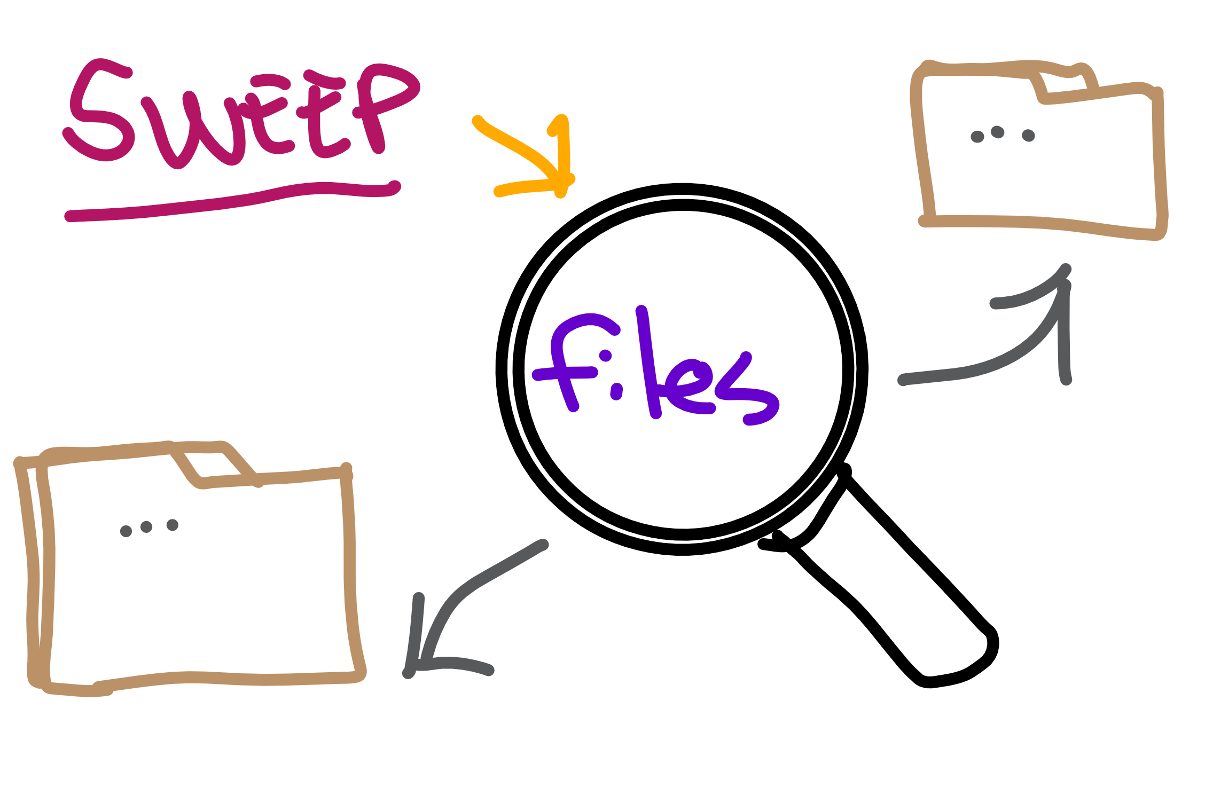

Slide 12
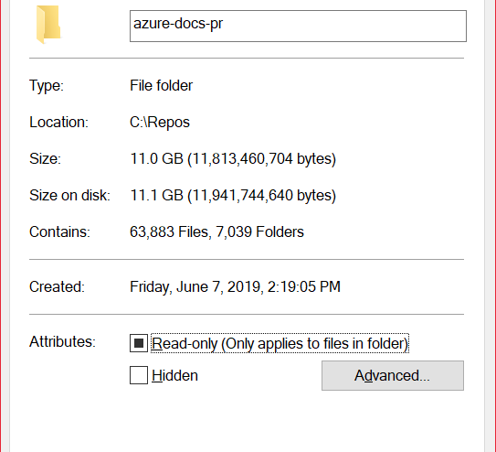

Highlights
11 GB
Over 63k files
Over 7k folders

Slide 13

Awesome, we’ve deleted some files… now what?

Slide 14
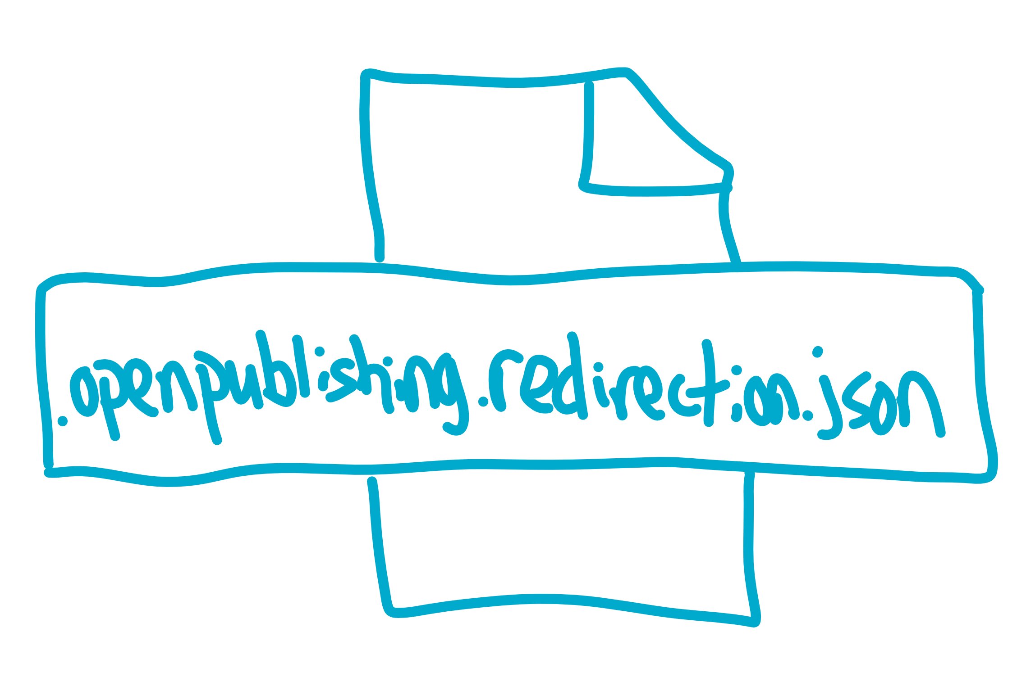

Slide 15
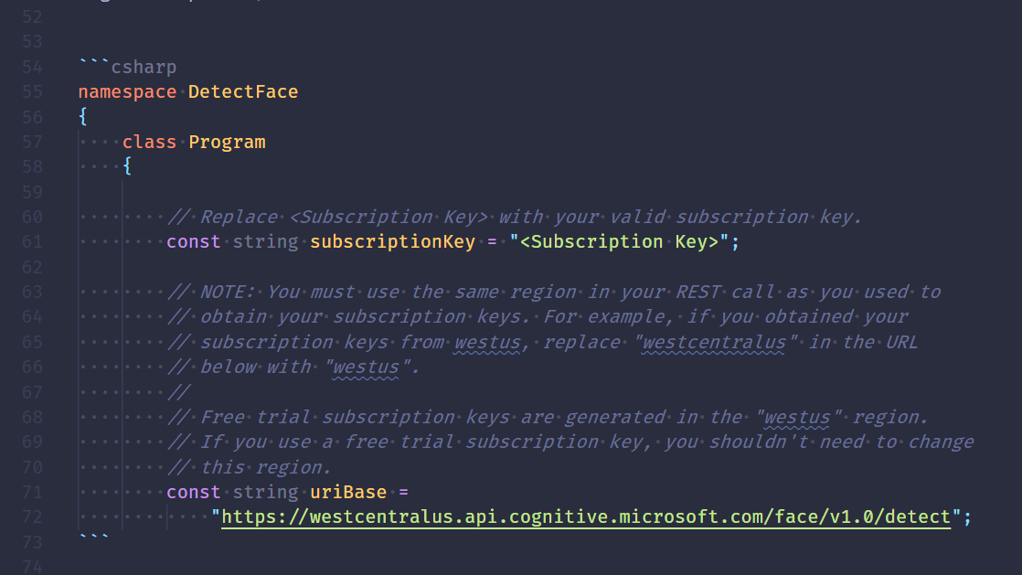
Code Fences
Slug Validation

Slide 16
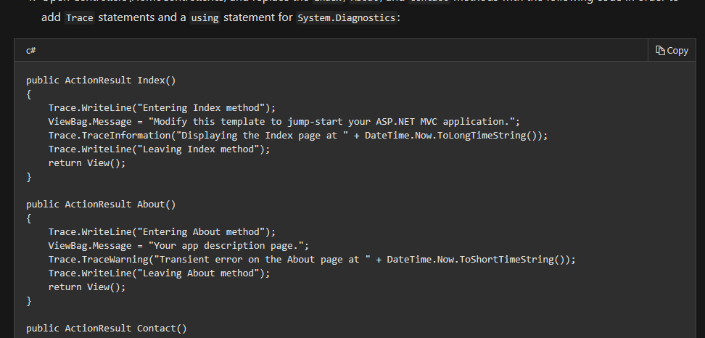


Slide 17
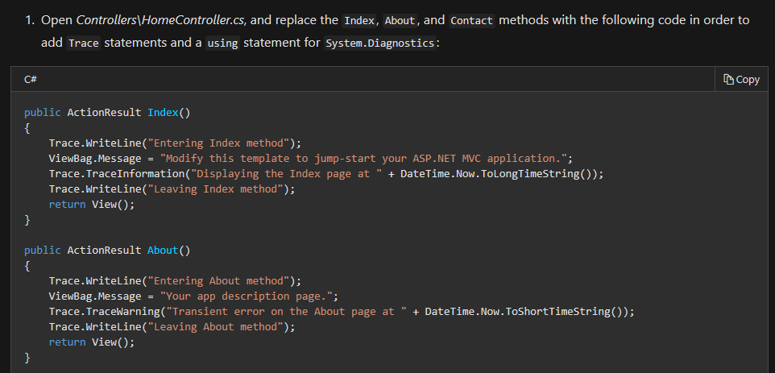


Slide 18
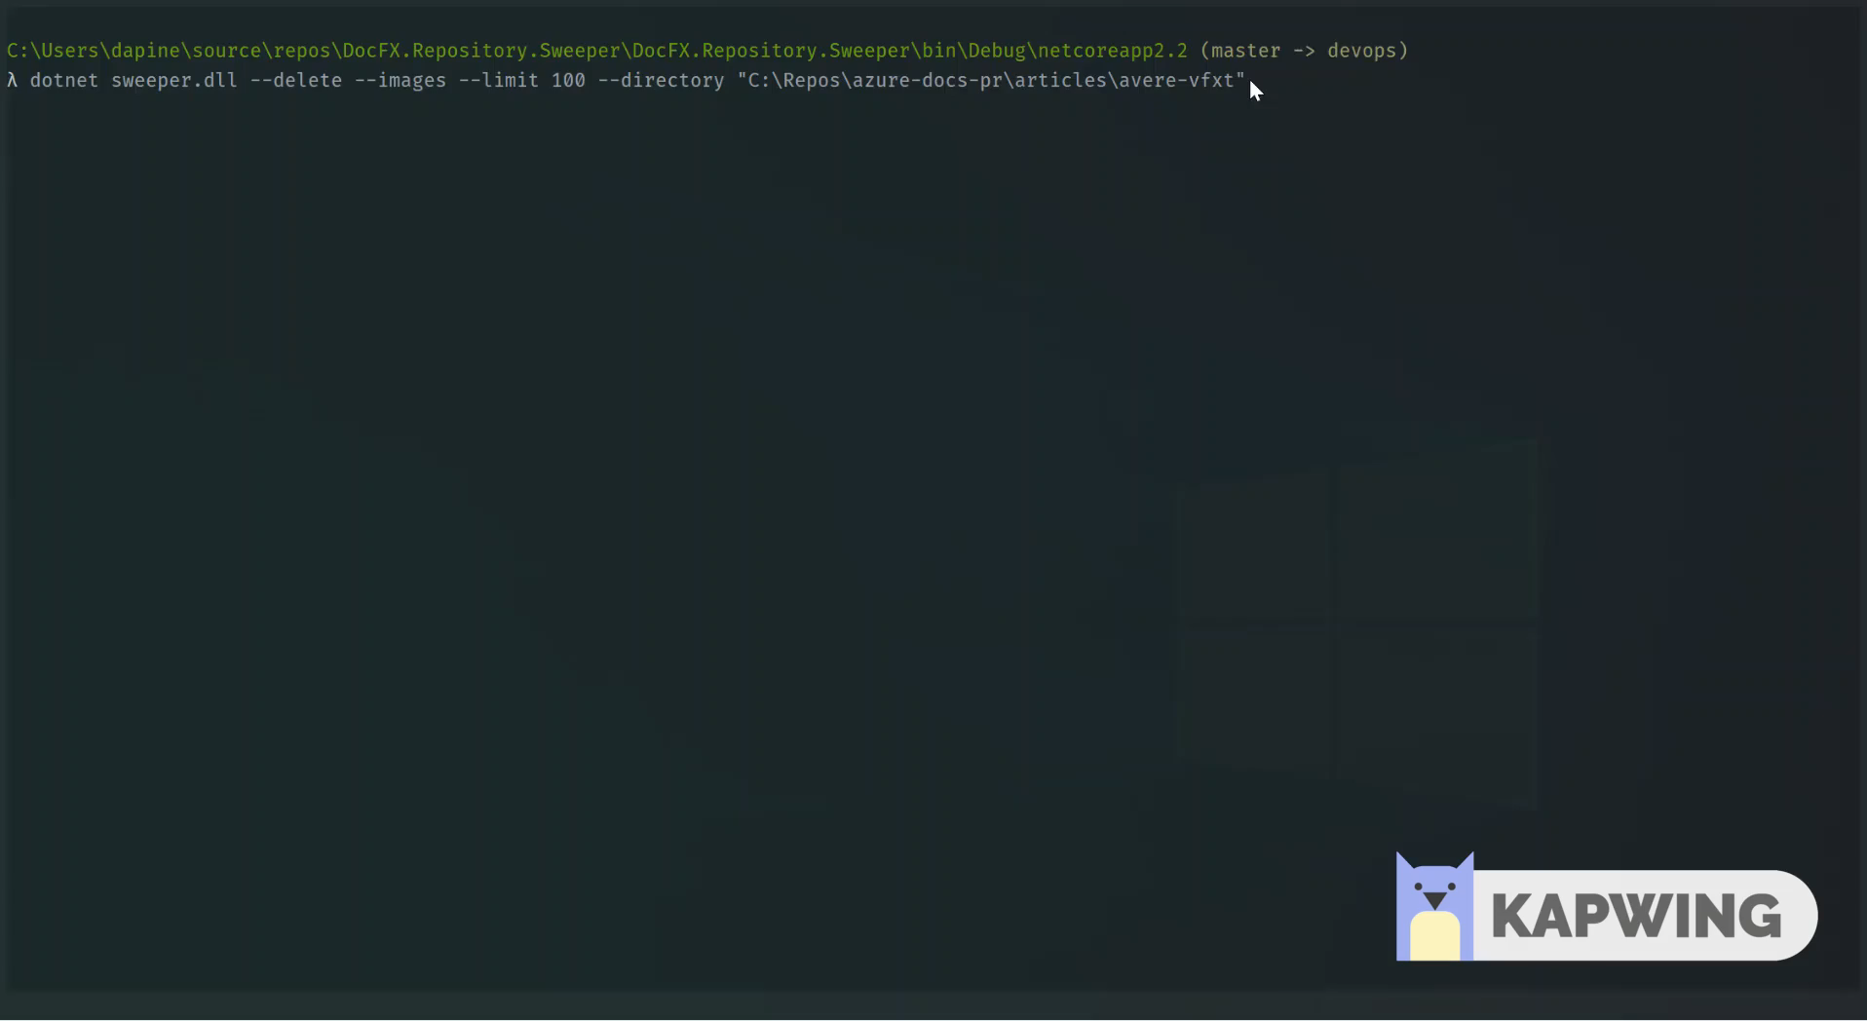
https://github.com/IEvangelist/DocFX.Repository.Sweeper

Slide 19
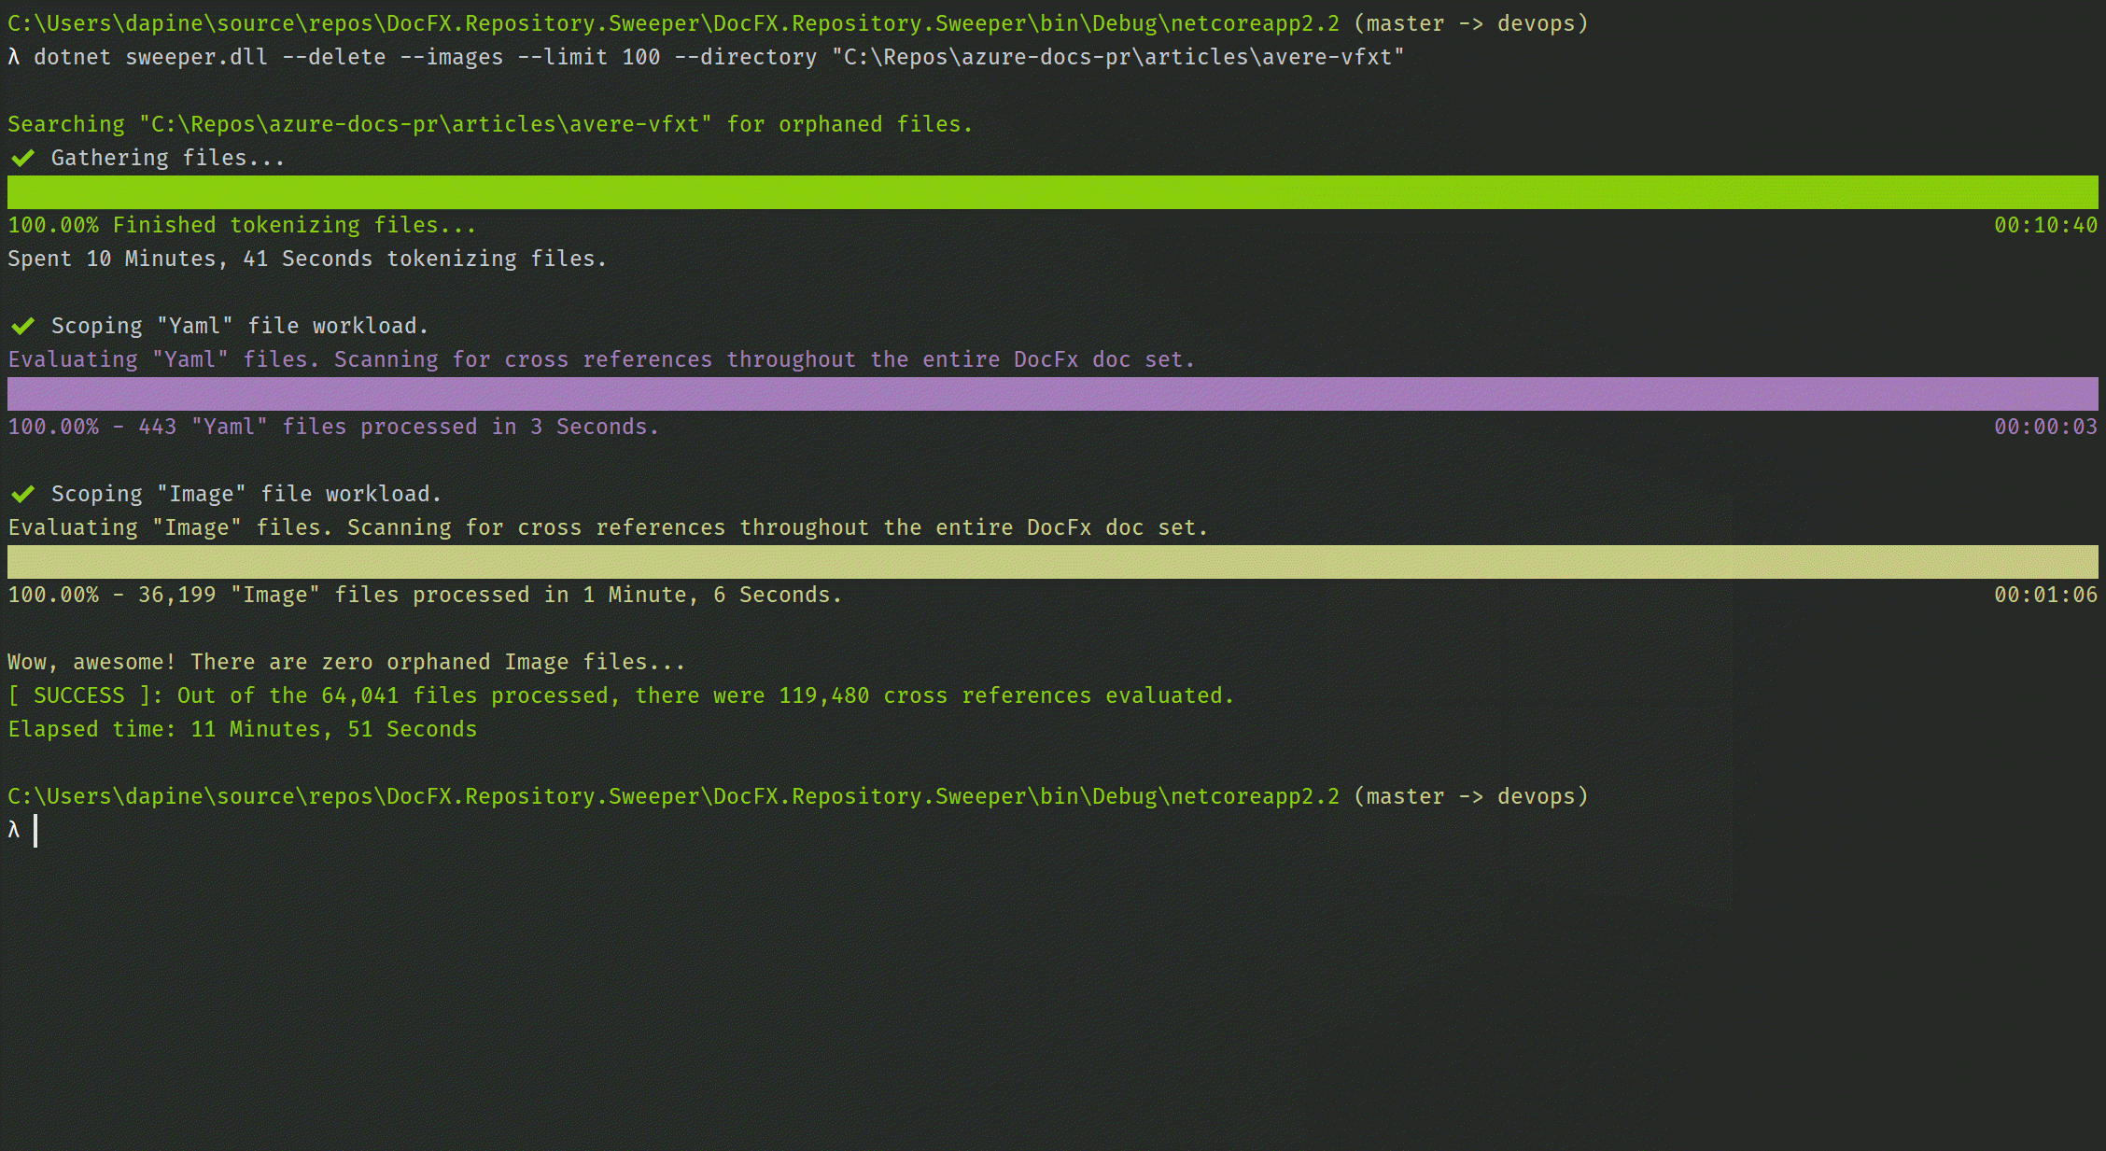

Slide 20
Future Ideas
Automatic GitHub issue creation for code fence validation errors or orphaned markdown files, tagging author with @Handle from metadata
Collaborate with “Docs Authoring Pack” extension team, enhance local markdown linter to incorporate some of these enhancements

Slide 21

Code Walk
Schedule a deep-dive with me and I’ll walk through the code

Slide 22

Thank you!

